Slide 1
http://ronanshonorsushistoryii.mrsronansclasses.com/Mrs._Ronans_Honors_U.S._History_II/Honors_U.S._History_II_Units/Entries/2013/1/23_Unit_Six__Imperialism.html

Slide 2
1. Establishing a U.S. presence in the Philippines will open new commercial opportunities in Asia, particularly in the vast markets of China.

Slide 3
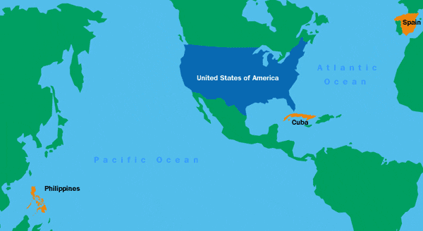

Slide 4
Fancy Primary Source Quote

Slide 5
Railway World: “One way of opening a market is to conquer it.... Already our enterprising merchants are beginning to take possession of the markets which our army and navy have opened to them.”

Slide 6
Railway World: “One way of opening a market is to conquer it.... Already our enterprising merchants are beginning to take possession of the markets which our army and navy have opened to them.”

Slide 7
Break it down

Slide 8
1. Establishing overseas colonies will be a drain on our government and offer few economic or military advantages in return.

Slide 9
1. Establishing naval bases and fueling stations in strategic locations overseas, such as Manila, will serve as an important instrument in advancing American commercial and security interests around the world.

Slide 10
Key Point #1
The United States has an obligation to uplift those people who are not blessed with America’s many liberties and privileges.

Slide 11
You are undertaking to to annex and make a component part of this government islands inhabitated by ten millions of the colored race, one half or more of whom are barbarians”
Senator Ben Tillman, South Carolina

Slide 12
You are undertaking to to annex and make a component part of this government islands inhabitated by ten millions of the colored race, one half or more of whom are barbarians”
Senator Ben Tillman, South Carolina

Slide 14
Basketball POV
You know POV better than you think you do.

Slide 15
Statement: Daniel “Tha White boy” Jocz is the best high school basketball player in the nation.
Source 1: Daniel's girlfriend, quoted in Daniel's school newspaper
Source 2: Mr. David Jocz, Daniel's father, private conversation with a work colleague
Source 3: Coach Jack Spratt, Daniel's basketball coach, letter of recommendation written on behalf of Daniel to UCLA

Slide 16
Statement: Daniel “Tha White Boy” Jocz is the best high school basketball player in the nation.
Source 4: Associated Press Poll of 100 sports writers, published in ESPN: The Magazine
Source 5: Mr. Phil Jackson, nine-time NBA championship coach, personal diary entry
Source 6: President Barack Obama, White House ceremony honoring Daniel's high school team as California State Champions
Source 7: Nike spokesperson, press statement announcing Daniel's $100 million endorsement deal

Slide 17
Source 1: Daniel's girlfriend, quoted in Daniel's school newspaper
Source 2: Mr. David Jocz, Daniel's father, private conversation with a work colleague
Source 3: Coach Jack Spratt, Daniel's basketball coach, letter of recommendation written on behalf of Daniel to UCLA
Source 4: Associated Press Poll of 100 sports writers, published in ESPN: The Magazine
Source 5: Mr. Phil Jackson, nine-time NBA championship coach, personal diary entry
Source 6: President Barack Obama, White House ceremony honoring Daniel's high school team as California State Champions
Source 7: Nike spokesperson, press statement announcing Daniel's $100 million endorsement deal

Slide 18
Some Useful POV Phrases
“It is not surprising that Source X would make this statement because . . .”
“This document is fairly reliable because . . .”
“The author of this document may be biased because . . .”
“Because Document 5 is a diary entry, the author is most likely not seeking to gain publicity or influence opinions.”

